Slide 1


Senthil Kumar P
ITG SharePoint

Slide 2

Agenda
Introduction
Brief Flashback of Cloud
Azure – What and Why
PaaS, IaaS and SaaS models
Azure Architecture
Components of Azure
Azure portal demo

Slide 3

Small Flashback
Salesforce.com (2004)
SaaS
Amazon Web Services (2006)
Public Cloud Platform
iPhone platform (2007)
Mobile services
Notes:
In the last few years, we have seen an explosive growth in the use of the public cloud. While most of the initial adoption was seen by startups and smaller orgs, most of the new growth will come from larger organizations adopting the public cloud.
Now you might ask what’s causing cloud adoption at such a fierce rate. There are 3 fundamentals business drivers at play here:
SPEED: With minutes instead of days/weeks to procure & provision servers, the pace of innovation has dramatically increased. Reduced ‘time to develop’ & ‘time to market’ means your IT can be much more agile in servicing needs of the business units or developers. Embrace & Enable Innovation. Help your business move forward against the competition. In fact, it is the speed and agility that IT hasn’t been able to provide has resulted in what many call “Shadow IT” where business units are resorting to using credit cards to procure computing resources outside of the purview of the IT.
SCALE: Cloud gives you an almost infinite set of computing resources. Your applications will enjoy massive global scale, and can easily scale up or down depending on the demand. That means, you never have to worry about running out of capacity or worry about overprovisioning. You use just enough resources for your needs - nothing more, nothing less.
ECONOMICS: And of course, you’re paying only for what you use in the Cloud. This in itself saves you money for any app that has variable computing needs. For some organizations, there is also an additional benefit of changing CapEX to OpEX, which frees up capital from infrastructure investments so it can be put to other uses.

Slide 4

Cloud????
Cloud: on-demand, scalable, multi-tenant, self-service compute and storage resources
Server Provisioning
Cloud Provisioning
Demand
Demand
Time
Overprovisioned
Time
Underprovisioned

Slide 5

Azure – “Sky Blue”
Azure: the color of the sky on a clear summer's day
_{Wikipedia}

Slide 6

Azure??

Slide 7
IaaS vs PaaS vs SaaS
On Premises
Infrastructure
(as a Service)
Platform
(as a Service)
Software
(as a Service)
Applications
Applications
You manage
Applications
Applications
You scale, make resilient and manage
You scale, make
resilient & manage
Data
Data
Data
Data
Runtime
Runtime
Runtime
Runtime
Scale, resilience and management by vendor
Middleware
Middleware5
Middleware
Scale, resilience and management by vendor
Middleware
O/S
O/S
O/S
O/S
Virtualization
Virtualization
Managed by vendor
Virtualization
Virtualization
Servers
Servers
Servers
Servers
Storage
Storage
Storage
Storage
Networking
Networking
Networking
Networking

Slide 8

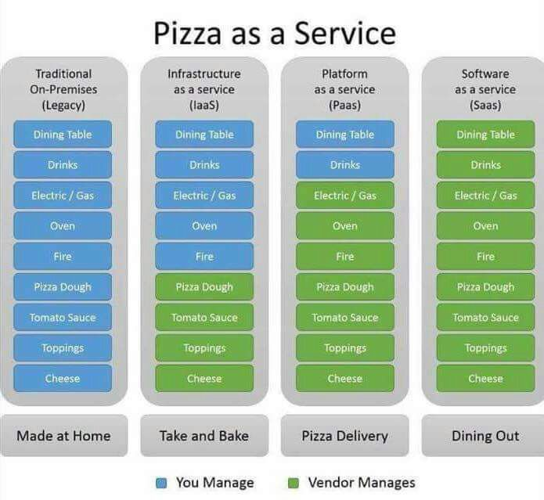

Slide 9
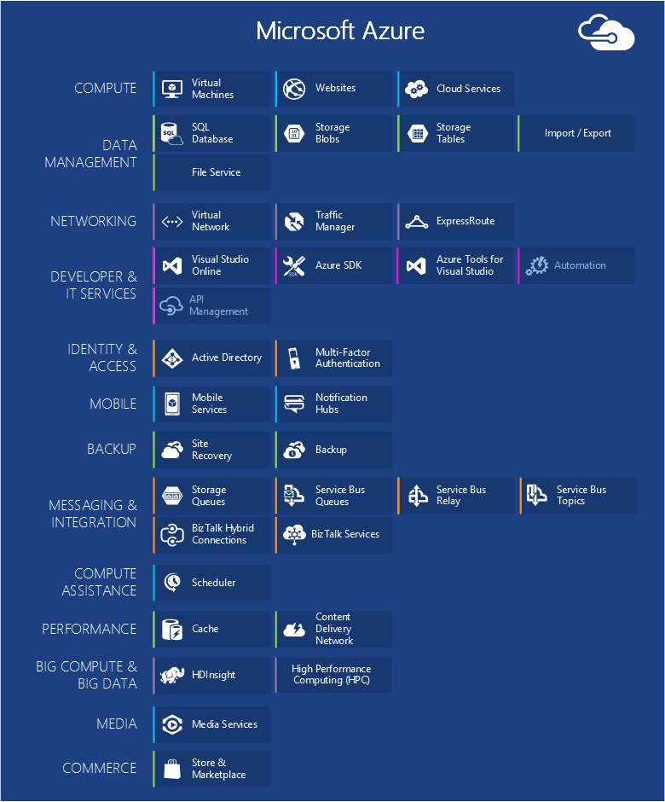

Slide 10





App Services (Animations for easy understanding)
Web sites
Web Apps
API app
App Service Plan
Logic App
Mobile services
Mobile Apps

Slide 11

Resource Group
A container that holds related resources
Deploy, manage, and monitor all the resources as a group, rather than handling these resources individually
Manage your infrastructure through declarative templates rather than scripts
We can apply tags to resources to logically organize all the resources in your subscription.
Each resource can only exist in one resource group.
Cloning of resource group helps us to organise resources well

Slide 12
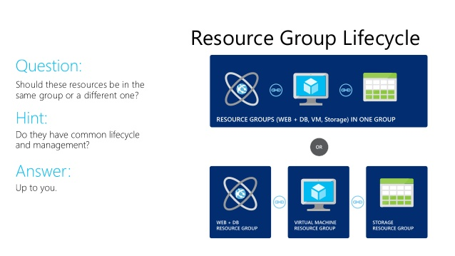
Resource Group(continued)

Slide 13

Virtual Machines
Quick Server setup at low cost without third party vendor
Power of the hybrid cloud
Create your own machine at cloud with necessary image file.
Enterprise applications with necessary licenses.
RDP client support to connect from anywhere.
Extended datacenter to act during peak hours for balancing the load.

Slide 14

Storage
Binary Large Object
Blob storage is a service that stores unstructured data in the cloud as objects/blobs
A container provides a grouping of a set of blobs(unlimited).
Azure Storage offers three types of blobs: block blobs, page blobs, and append blobs.
Block blobs are ideal for storing text or binary files, such as documents and media files.
Append blobs are similar to block blobs in that they are made up of blocks, but they are optimized for append operations, so they are useful for logging scenarios.
A single block blob can contain up to 50,000 blocks of up to 100 MB each, for a total size of slightly more than 4.75 TB (100 MB X 50,000).
A single append blob can contain up to 50,000 blocks of up to 4 MB each, for a total size of slightly more than 195 GB (4 MB X 50,000).
Each version of the blob has a unique tag, called an Etag.
Page blobs can be up to 1 TB in size, and are more efficient for frequent read/write operations.
Rio 2016 broadcast across regions where done using blob as peta bytes(note it well not even tera bytes).

Slide 15

Traffic Manager
Failover, distribution from primary to secondary end point
Performance, routing to closest geographical server
Even distribution of requests using Round Robin method.
Intelligent DNS resolver.
Acts like a agent when you go to a bank, it doesn’t take load instead it just routes you the right place.
TM acts across various regions in globe while load balancer acts within region.

Slide 16

Redis Cache
Remote Dictionary Service
Extremely Fast
Open source Cache service available
Great boost to performance
Available in three tiers
Basic – Cache service optimal for dev purpose(non critical workloads)
Standard – Primary and Secondary Config and High availability SLA
Premium – Disaster recovery, enhanced security, azure virtual network
Scripting can be done by LUA language.
Emerged from Portuguese word which means Moon.
LUA is a multi paradigm language

Slide 17


Other notable components
Virtual Network
Web Role
Worker Role
Public IP Address

Slide 18

Application Insights
Application Performance Management (APM) service for web developers on multiple platforms
Monitor your live web application as dashboards.
Request rates, response times, and failure rates
Exceptions
Page views and load performance
User and session counts.

Slide 19

Demo of Portal

Slide 20

Resources
References
Learning
Sessions on Demand
Microsoft Certification & Training Resources
http://channel9.msdn.com/Events/TechEd
www.microsoft.com/learning
TechNet
Developer Network
Resources for IT Professionals
http://microsoft.com/technet
http://developer.microsoft.com

Slide 21


